Slide 1

“Brain Tumor Detection Using Deep Learning”
Department Of Computer Science and Engineering Jawaharlal Darda Institute of Engineering & Technology, Yavatmal, (M.S), India-445001 Session 2023-2024
Presented by :
Mr. Chetan A. Muneshwar
Mr. Raunak J. Pipariya
Mrs. Shreya N. Nathile
Mr. Amit S. Khandare
Guided by :
Prof. M. K. Popat

Slide 2
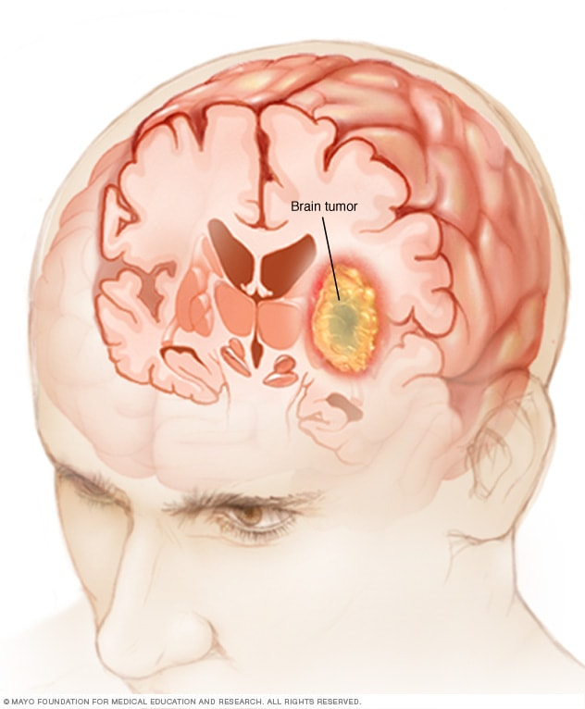
CONTENT:
Objective
Research Methodology
Data Flow Diagram
Flowchart
Working
Algorithm Detail
Model Representation
Conclusion
References

Slide 3
OBJECTIVE:
Brain tumor at early stage is very difficult task for doctors to identify.
MRI images are more prone to noise and other environmental interference.
So, it becomes difficult for doctors to identify tumor and their causes.
So here we come up with the system, where system will detect brain tumor from images.
• Save patient’s time.
• Provide a solution appropriately at early stages.
• Get timely consultation.

Slide 4
RESEARCH METHODOLOGY:
The system will have mainly five modules.
Dataset: In dataset we can take multiple MRI images and take one as input image
Pre-processing: In pre-processing image to encoded the label and resize the image.
Split the data: In split the data we set the image as Training Data and Testing Data.
Build CNN model: To train Deep Neural network for classification.
Classification: Used to classify the Brain tumor

Slide 5
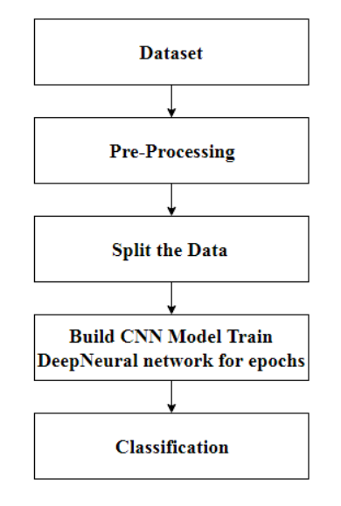
Data Flow Diagram:
START
END

Slide 6
Flowchart:
Start
Input MRI Image from dataset
Image Preprocessing
CNN feature Extraction + Classification
If Tumor is detected
?
NO
YES
Preprocessing
Normal
Segmentation
Area of classification of brain tumor
Glioma
Meningioma
Output
Pituitary

Slide 7
WORKING
Start: The process begins here.
Input MRI Image from dataset: An MRI image is taken as input from a dataset. This image likely contains brain scan data.
Image Preprocessing: The input image undergoes preprocessing steps. These steps may involve noise reduction, contrast enhancement, and other techniques to prepare the image for further analysis.
CNN Feature Extraction + Classification: A Convolutional Neural Network (CNN) is used for feature extraction and classification. CNNs are commonly used for image analysis tasks. Features relevant to brain tumor detection are extracted from the preprocessed image.
Is Tumor detected?:
If the CNN detects a tumor, the flow proceeds to the “YES” path.
If no tumor is detected, the flow proceeds to the “NO” path.

Slide 8
6. NO (Normal): If no tumor is detected, the result is classified as “Normal.”
7. YES (Tumor Detected):
Further processing steps are performed for the detected tumor.
These steps may include additional preprocessing and segmentation.
8. Segmentation Area of classification of brain tumor:
The tumor area is segmented to classify it into specific types.
The three possible classifications are:
Glioma
Meningioma
Pituitary
9. Output: The final output provides the classification of the brain tumor based on the MRI image.

Slide 9
Algorithm use in project:
CNN Algorithm:
CNN's, also known as Convolutional Neural Network, consist of multiple layers and are mainly used for image processing and object detection.
CNN's are widely used to identify satellite images, process medical images, forecast time series.
CNN's have multiple layers that process and extract features from data:
Convolution Layer:
CNN has a convolution layer that has several filters to perform the convolution operation.
Rectified Linear Unit (ReLU):
CNN's have a ReLU layer to perform operations on elements. The output is a rectified feature map.

Slide 10
Pooling Layer:
The rectified feature map next feeds into a pooling layer. Pooling is a down-sampling operation that reduces the dimensions of the feature map.
The pooling layer then converts the resulting two-dimensional arrays from the pooled feature map into a single, long, continuous, linear vector by flattening it.
Fully Connected Layer:
A fully connected layer forms when the flattened matrix from the pooling layer is fed as an input, which classifies and identifies the images.
Padding:
Padding is incorporating a zero layer outside the input volume so the data on border won't be lost and we can get a similar dimension of output as input volume. Here we are using zero padding.

Slide 11
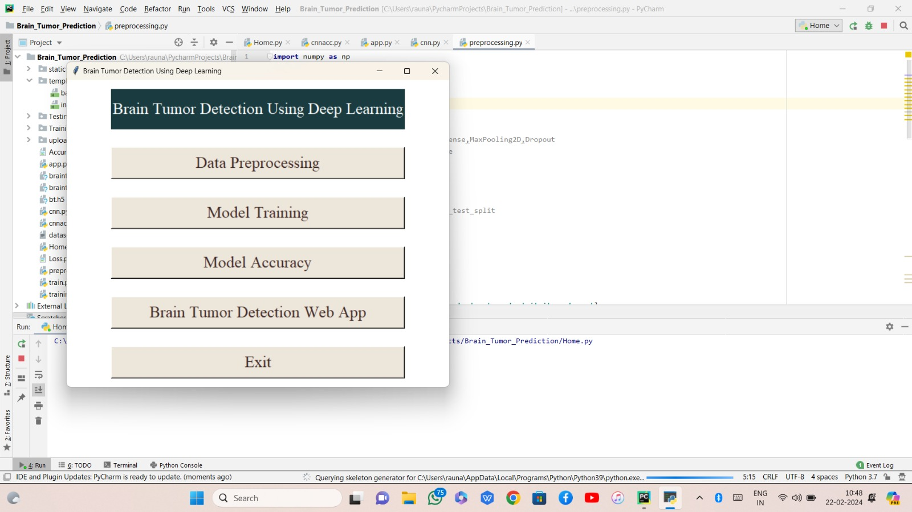
MODEL REPRESENTATION

Slide 12
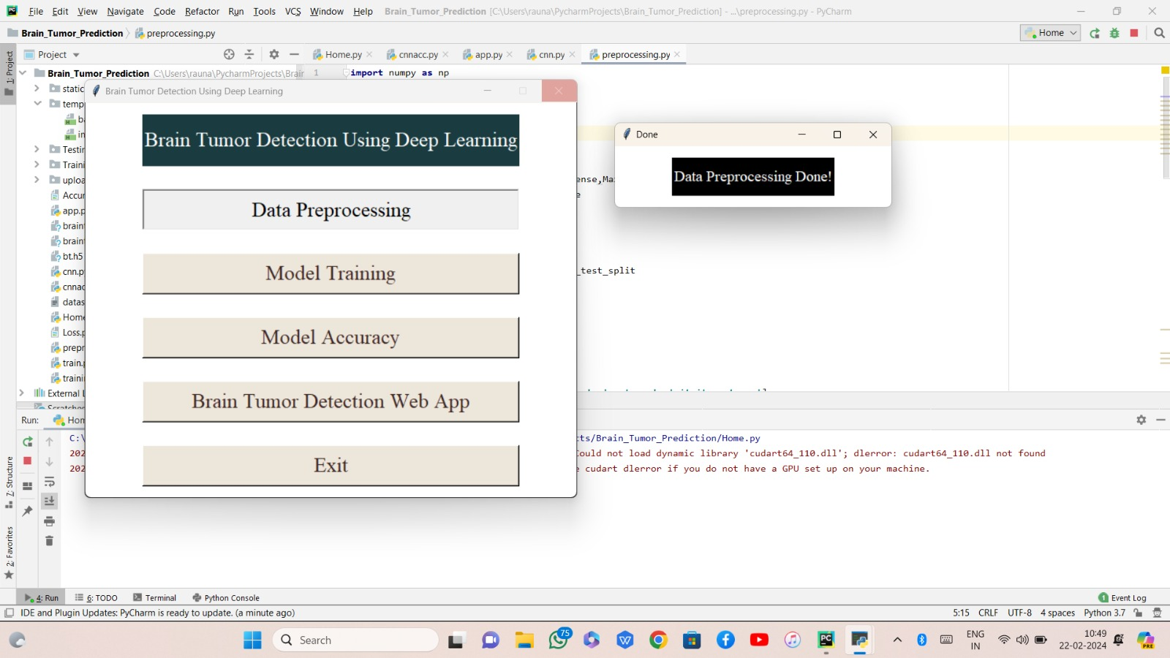

Slide 13
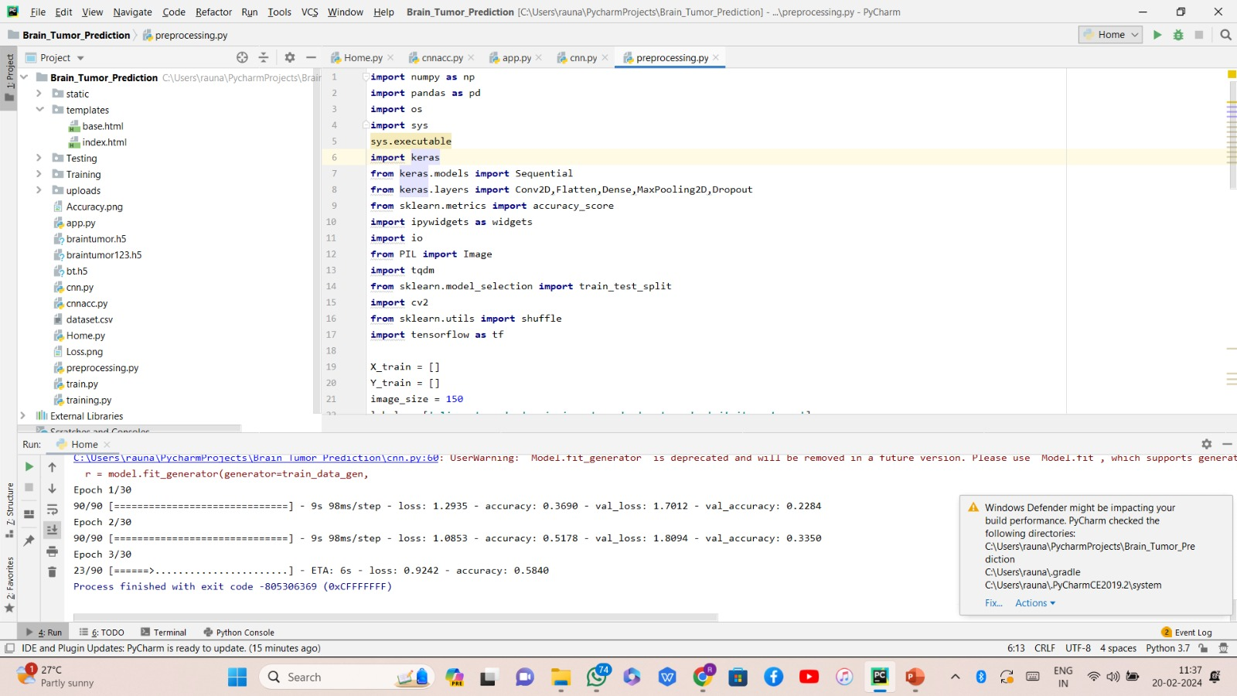

Slide 14
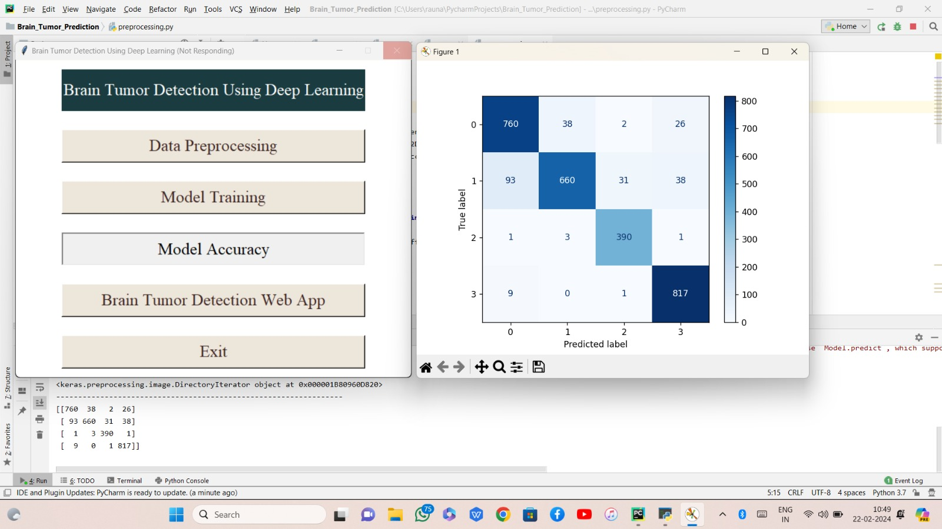

Slide 15
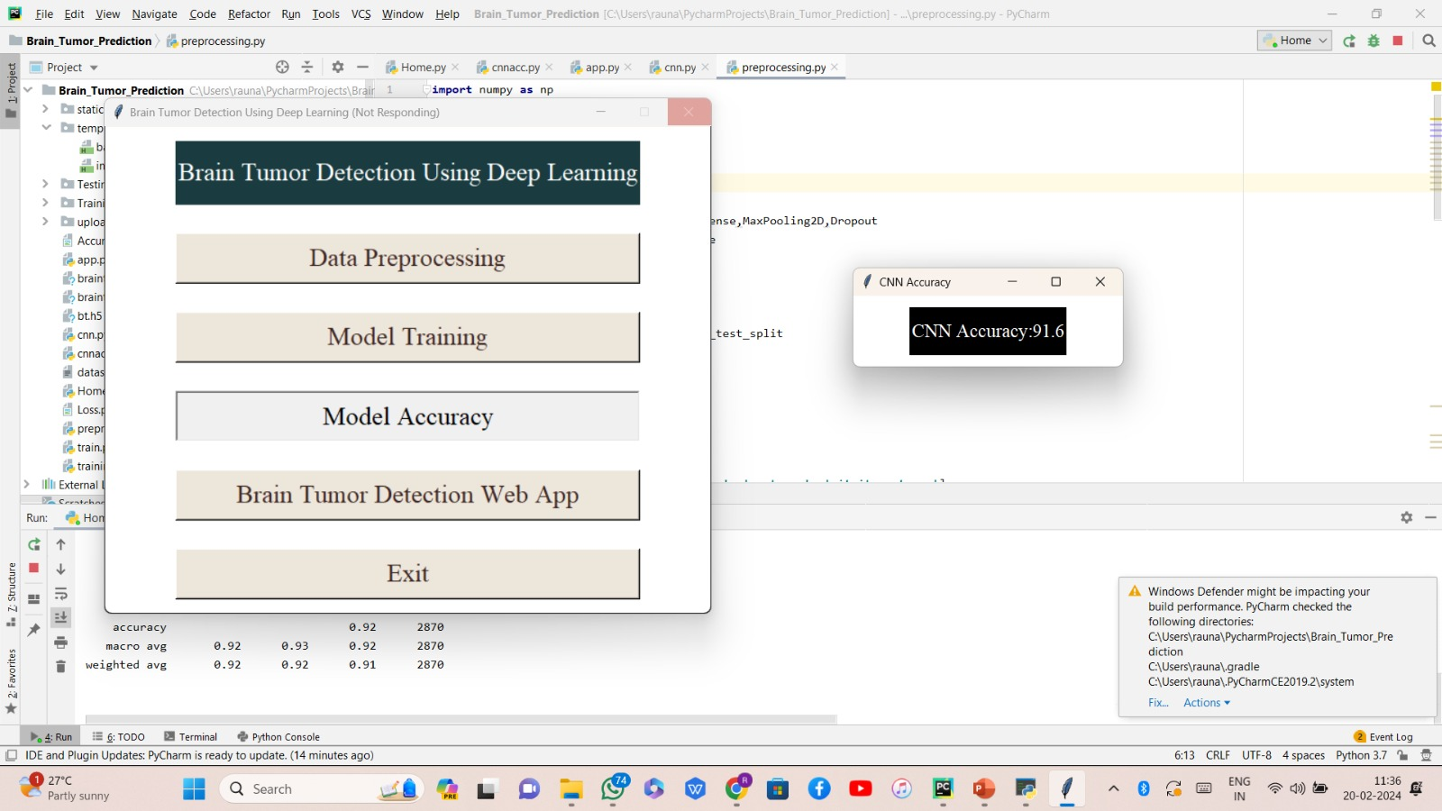
Derived Accuracy:

Slide 16
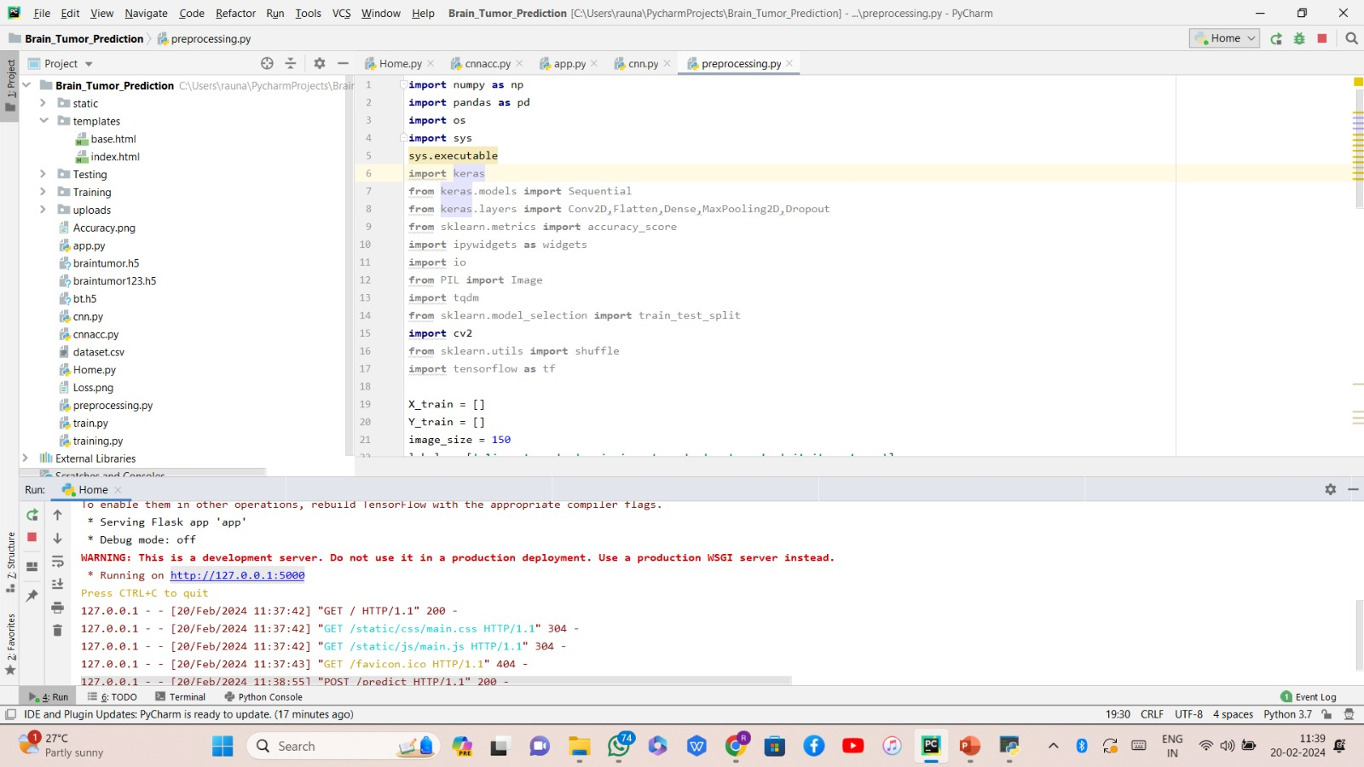
8+
Website link Activation

Slide 17
CONCLUSION:
In our study, we utilized a dataset of Brain MRI images and applied four Convolutional Neural Network (CNN) models for the task of classifying the scans into four different classes: Glioma, Meningioma, No tumor, and Pituitary. The purpose was to evaluate the performance of these models in accurately identifying brain tumor.

Slide 18
REFERENCES:
Minu Samantaray, Millee Panigrahi, K.C. Patra, Avipsa S. Panda, Rina Mahakud “An adaptive filtering technique for brain tumor analysis and detection” 2016 10th International Conference on Intelligent Systems and Control (ISCO)
2. Sneha Grampurohit, Venkamma Shalavadi, Vaishnavi R. Dhotargavi, Megha Kudari, Mrs Soumya Jolad “BRAIN TUMOR DETECTION USING DEEP LEARNING MODELS” 2020 IEEE India Council International Subsections Conference (INDISCON)
3. Avigyan Sinha, Aneesh R P, Malavika Suresh, Nitha Mohan R, Abinaya D, Ashwin G Singerji “Brain Tumor Detection Using Deep Learning” 2021 Seventh International conference on Bio Signals, Images, and Instrumentation (ICBSII)
4. S. Pereira, A. Pinto, V. Alves, C.A. Silva. (2016). “Brain tumor segmentation using convolutional neural networks in MRI images”, IEEE transactions on medicalimaging,pp.1240-1251, 2016. https://doi.org/10.1109/TMI.2016.2538465.
5. X.W. Gao, R. Hui, Z. Tian. (J2017). “Classification of CT brain images based on deep learning networks, Computer methods and programs in biomedicine”,pp.49-56,Jan2017. https://doi.org/10.1016/j.cmpb.2016.10.007.

Slide 19
ANY QUESTIONS !!!

